Slide 1
Smog Prediction

Slide 2
01
03
02
04
About the Project
Dataset Status
Dataset
Sneak Peek
Notes:
about the project
dataset
dataset status
sneak peak of all the work

Slide 3
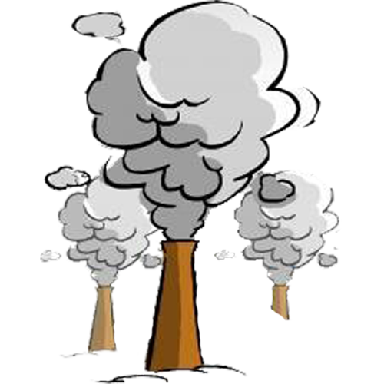
Air Pollution & Smog
Air pollution that reduces visibility and causes respiratory diseases. Photochemical smog from nitrogen oxides reacting with sunlight
Notes:
air pollution is when nitrogen oxides react with sunlight too produce photochemical fog. This reduces visibility and causes respiratory diseases

Slide 4
Sources
Coal Power Plants
Burning coal releases CO an NO
Car Exhausts
Nitrogen oxides from car exhausts
Factory Emissions
SO from gasoline, paints & cleaning solvents
Notes:
What are some of the major sources
-

Slide 5
01
About the Project
What is the idea and implementation?

Slide 6

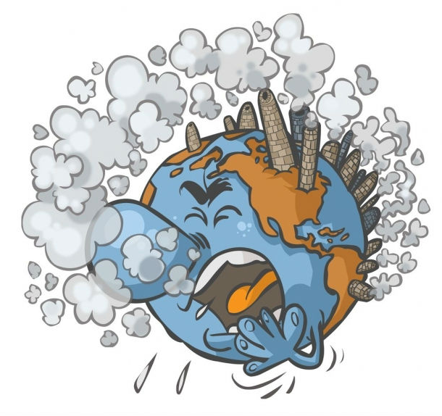
Idea
Collect data about major air pollutants over a defined geographical area. Identify hazardous trends and use that learning to predict possibilities in near future

Slide 7
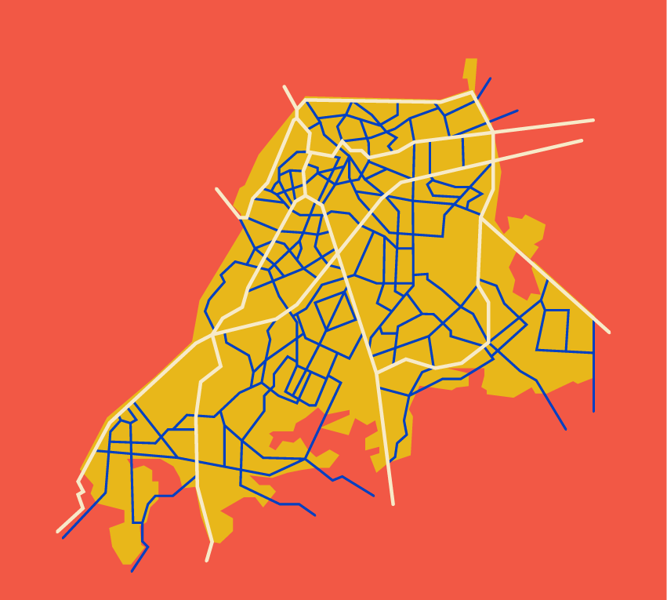
Notes:
Insert map and grid here

Slide 8
Dataset
CO
No & No2
Interferes with oxygen delivery system of body
Causes chronic lung diseases
pm2_5
pm10
O3
So2 & Nh3
Reduces lung function and inflame lung lining
Causes eye irritation and burning in respiratory tract
Notes:
Pm are particles reported as micrograms per cubic meter
All other gasses are reported as pollutant concentration in micrograms per meter cube of air
Next slide shows how an estimate of air quality index will be calculated

Slide 9
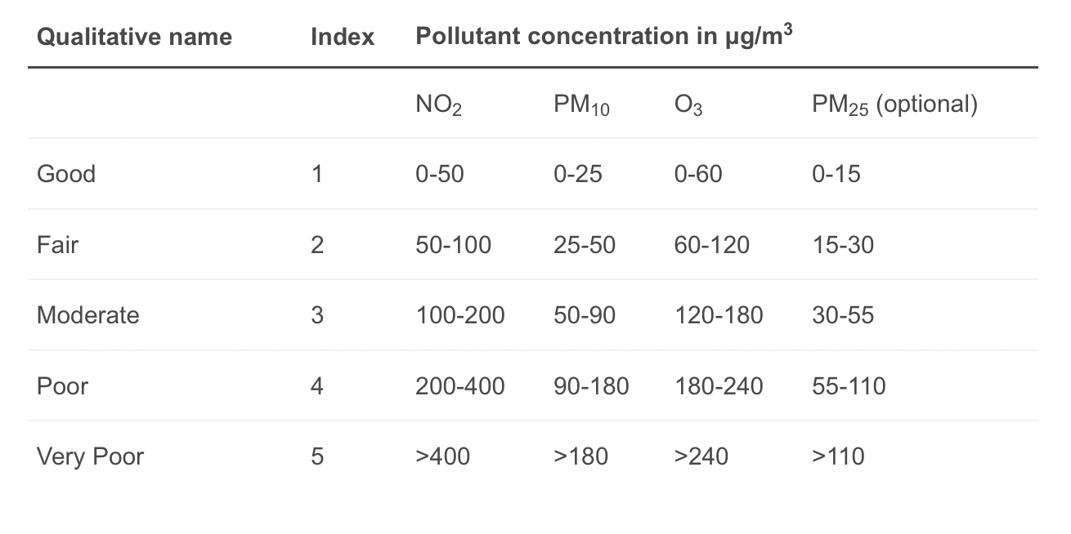
Dataset
Notes:
Pm are particles reported as micrograms per cubic meter
All other gasses are reported as pollutant concentration in micrograms per meter cube of air
Next slide shows how an estimate of air quality index will be calculated

Slide 10
Dataset Status
2160
64800
Expected Daily Records
Expected Monthly Records
(90 zones) * (24 hours)
(2160 daily) * (30 days)

Slide 11
32,400
Current data from past 15 days

Slide 12
1,550,000
Data of 2021 and 2022

Slide 13
Sneak Peek

Slide 14
Timeline
Capture
Prediction
Store API responses
Train model for predictions
Preprocessing
Visualization
Clean data and extract features
Present all data in an interactive way
Notes:
What is the timeline of project

Slide 15
Now
Capture data from API and perform some preprocessing tasks
● Extract required features and transform data
● Store the correct output into a retrievable format
● Prepare data to be fed into model
Notes:
How API response is captured, transformed and stored

Slide 16
Future
Making future predictions using identified trend and current data
● Naive Bays
● Neural Network
Interactive visualization of collected data to display trends
● Tableau or Power Bi
● JavaScript frameworks
Notes:
All possible predictions and the strategy you have decided on how to train your model.

Slide 17
Thank You
Abdul Saboor | 20L-1113 | BDS-5A

